Slide 1
Profiles, Audiences, and My Sites
Module 8

Slide 2
Agenda
Profiles
Audiences
Targeting
My Sites

Slide 3
Importing profile information
Pull users and profile information from
Active Directory – Also imports group membership
LDAP
BDC
Import on schedule
Accepts connection filters
This information is now available for search
Populates info on My Site
Compile audiences based on info

Slide 4
Default Properties
46 properties OOTB
21 mapped to AD attribute
Completely configurable
Mapping to ad
User editable
Privacy settings

Slide 5
More on profiles
Profile information is pulled from AD on first site access
Profile Sync job
Syncs changes from profile database to site
Name change example

Slide 6
Demo!
Look at profile import connections
Look at profile properties & mappings

Slide 7
Global Audiences
Compile based on account or profile properties
Used to target
Links
Web parts
Schedule compile for after profile import

Slide 8
Other Targeting
All Web Parts
Choose from
Global Audiences
Distribution/Security Groups
SharePoint Group
Content Query Web Part/List filtering
List Enable audience targeting
Creates new column – Assign target
CQWP has filter to use targeting

Slide 9
Demo!
Creating a global audience
Targeting Web Parts
The Content Query Web Part

Slide 10
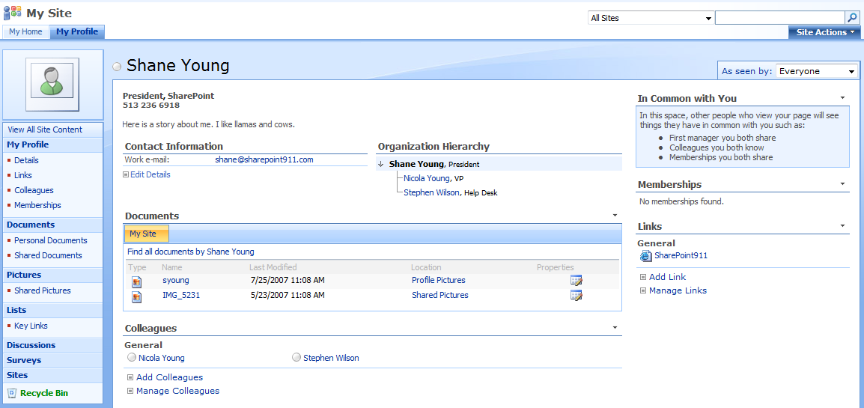
My Sites
Sites allow users a personal SharePoint site
Can be used to expand people networking

Slide 11
Personal Site
Automatically created first time accessed
Creates a new site collection (set quotas)
Allows user to edit profile information
Provides tools for organization
Provides both public and private storage
Web Parts for accessing Exchange
Can create additional lists and sub-sites

Slide 12
People networking
Add a picture
Colleague tracker
Contact info
Special, “In common with you” web part
Memberships
Information is available via search
People search tab in Search Center
Sort by social distance
Refine by Job Title or Department

Slide 13
Demo!
Fun with My Sites
Other personalization settings
Personalization site links
Published links to Office client applications
Discussion of moving My Sites

